Slide 1

Permutation & Combination
Anuja P Sobhan
CIR

Slide 2
Fundamental Principle of Counting Addition
If there are two jobs such that they can be accomplished independently in a and b ways respectively, then either of the two jobs can be accomplished in (a + b) ways.
Example 1:In a class, there are 15 boys and 10 girls. The teacher wants to select a boy or a girl so as to represent the class in a function. In how many ways can the teacher make the selection?
The first task can be accomplished in 15 ways and the second in 10 ways. By fundamental principle of addition, either of the two jobs can be accomplished in: 15 + 10 = 25 ways.

Slide 3
Fundamental Principle of Counting Multiplication
If there are two jobs such that one of them can be completed in p ways, and after its completion in any one of these p ways, the second job can be completed in q different ways, then the two jobs (in succession) can be completed in p × q ways
Example 2:In a class, there are 15 boys and 10 girls. The teacher wants to select one boy and one girl, so as to represent the class in a function. In how many ways can the teacher make the selection?
The first task can be done in 15 ways and the second in 10 ways.
The total number of ways is: 15 × 10 = 150.

Slide 4
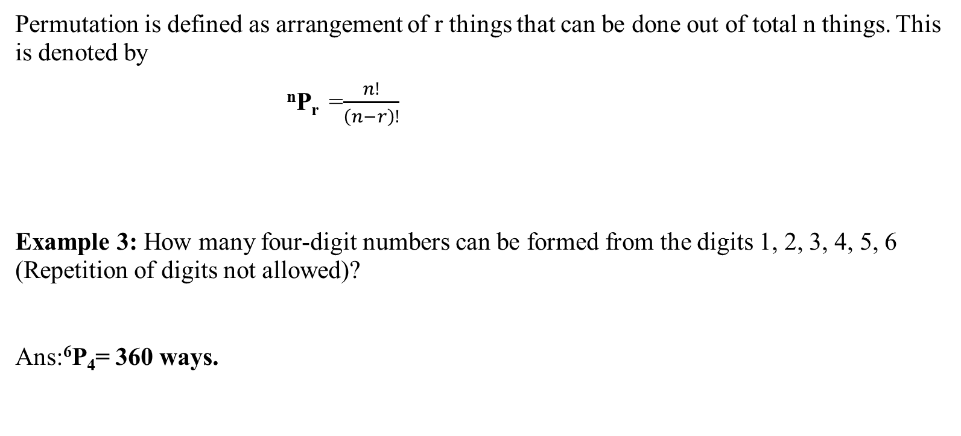
Permutation
Permutation is defined as arrangement of r things that can be done out of total n things. This is denoted by
^{n}P_{r} =$\frac{n!}{\left(n−r\right)!}$
Example 3: How many four-digit numbers can be formed from the digits 1, 2, 3, 4, 5, 6 (Repetition of digits not allowed)?
Ans:⁶P₄= 360 ways.

Slide 5
No of permutations of N things out of which P are alike and are of one type,Q are alike and are of a second type and R are alike and are of third type and the rest are all different= N!/P!Q!R!
MALAYALAM
Example 4:The number of words formed with the letters of the word 'MALAYALAM'
Ans:9!/(2!4!2!)

Slide 6
Number of ways of selecting zero or more things from ‘n’ different things is given by:- 2^{n}
Number of ways of selecting 1 or more things from ‘n’ different things is given by:- 2^{n}-1
Example 5: Ram has 8 friends. In how many ways can he invite one or more of them to dinner?
Ram can select one or more than one of his 8 friends
=> Required number of ways =2⁸ – 1= 255.

Slide 7
Number of permutations of n different things taken r at a time when repetition is allowed =n^{r}
Example 6: In how many ways can 3 non- identical rings be worn in 5 fingers ?
Ans:5*5*5=5³

Slide 8
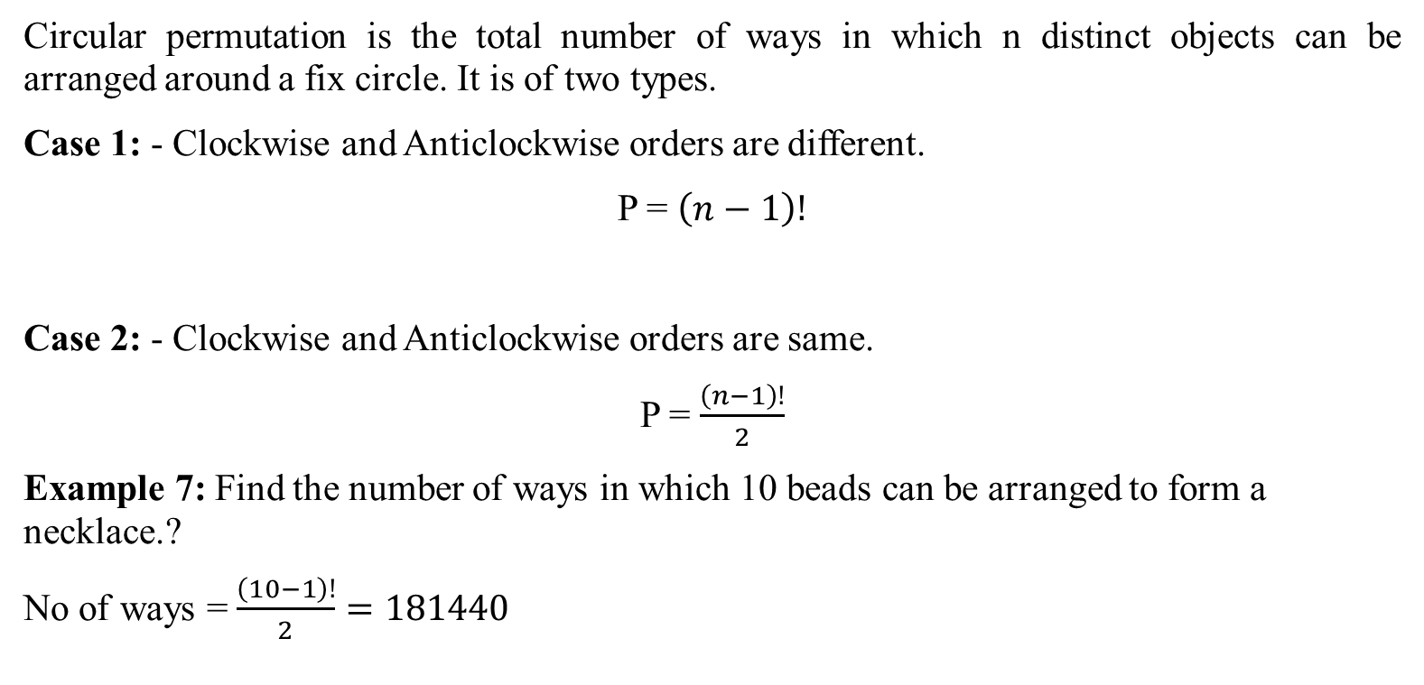
Circular Permutation
Circular permutation is the total number of ways in which n distinct objects can be arranged around a fix circle. It is of two types.
Case 1: - Clockwise and Anticlockwise orders are different.
P = $\left(n−1\right)!$
Case 2: - Clockwise and Anticlockwise orders are same.
P = $\frac{\left(n−1\right)!}{2}$
Example 7: Find the number of ways in which 10 beads can be arranged to form a necklace.?
No of ways = $\frac{\left(10−1\right)!}{2}=181440$

Slide 9
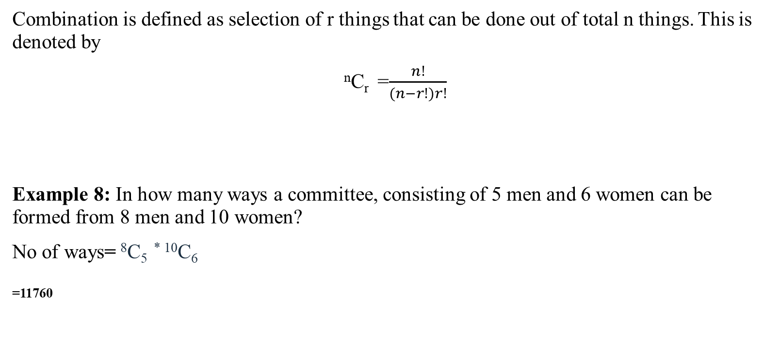
Combination
Combination is defined as selection of r things that can be done out of total n things. This is denoted by
^{n}C_{r} =$\frac{n!}{(n−r!)r!}$
Example 8: In how many ways a committee, consisting of 5 men and 6 women can be formed from 8 men and 10 women?
No of ways= ⁸C₅ ^{* 10}C₆
₌₁₁₇₆₀

Slide 10
Number of ways of distributing n identical things among r person when each person may get any number of things =^{n+r-1} C _{r-1}
Example 8:In how many ways can 5 apples (identical) be distributed among 4 children? (Some children may get no apples.)
n=5,r=4
Required no of ways = ⁽⁵⁺⁴⁻¹⁾C₍₄₋₁₎ = ⁸C₃ = 8*7*6/3! = 8*7 = 56 ways

Slide 11
Alternate Method
5 apples can be distributed in various ways: {5, 0, 0, 0}, {4, 1, 0, 0}, {3, 2, 0, 0}, {3, 1, 1, 0}, {2, 2, 1, 0}, {2, 1, 1, 1}.
{5, 0, 0, 0}=4 ways
{4, 1, 0, 0}= 4!/2! = 12 ways
{3, 2, 0, 0}=4!/2! = 12ways
{2, 2, 1, 0}=4!/2! = 12ways
{2, 1, 1, 1}=4!/3! = 4 ways
In all, 5 identical apples can be distributed among 4 children in 4 + 12 + 12 + 12 + 12 + 4 = 56 ways

Slide 12
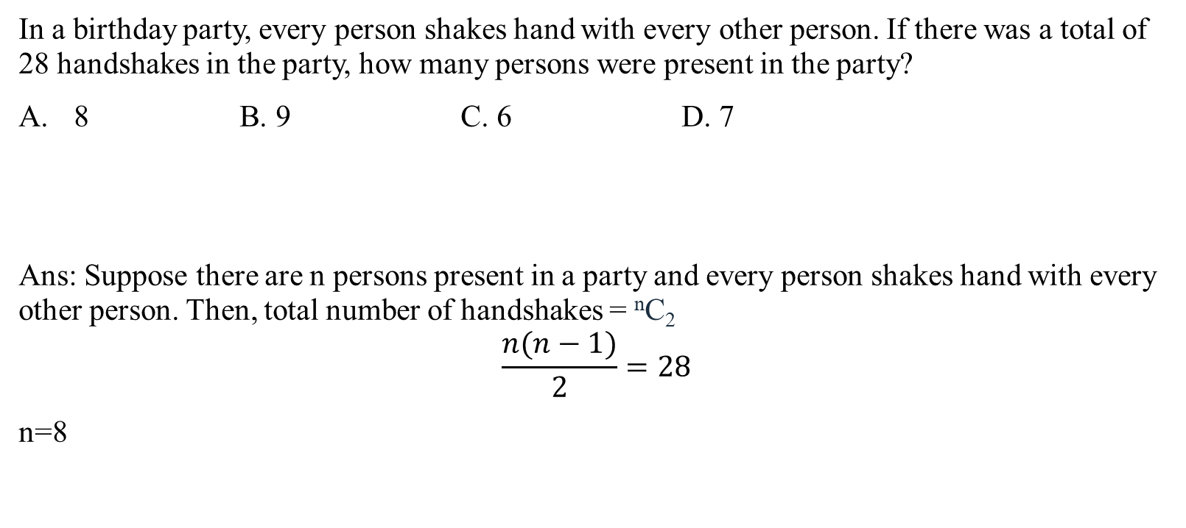
Handshake Problem
In a birthday party, every person shakes hand with every other person. If there was a total of 28 handshakes in the party, how many persons were present in the party?
8 B. 9 C. 6 D. 7
Ans: Suppose there are n persons present in a party and every person shakes hand with every other person. Then, total number of handshakes = ^{n}C₂
$$\frac{n(n−1)}{2}=28$$
n=8

Slide 13
Example 9: What is the number of ways in which you can distribute 5 balls in 3 boxes when:
Case 1: Balls are same; boxes are same Case 2: Balls are same; boxes are different Case 3: Balls are different; boxes are same Case 4: Balls are different; boxes are different

Slide 14
Balls are same; boxes are different
The different arrangements are {5, 0, 0}, {4, 1, 0}, {3, 2, 0}, {3, 1, 1}, {2, 2, 1}, {2, 1, 1}.
(0,0,5)=3!/2!=3
(0,1,4)=3!=6
(0,2,3)=3!=6
(1,1,3)=3!/2!=3
(1,2,2)=3!/2!=3
Total=3+6+6+3+3=21 ways

Slide 15

Balls are different; boxes are same
(0,0,5)=1 way
(0,1,4)=⁵C₁$×\text{4}\text{C}\text{4}$ =5ways
(0,2,3)= ⁵C₂ $×\text{3}\text{C}\text{3 }$ =10ways
(1,1,3)= ⁵C₃$×\text{2!/2}$= 10ways
(1,2,2)= ⁵C₁ $×\text{4}\text{C}\text{2}$ $×\text{2}\text{C}\text{2 }$/2=15ways
Total=1+5+10+10+15=41ways

Slide 16

Balls are different; boxes are different
(0,0,5)=>Balls=1ways,Boxes=3ways
Total=3ways
(0,1,4)=>Balls=5c1=5ways,Balls=3!ways
Total=5*6=30ways
(0,2,3)=>5C2=10ways,Balls=3!ways
Total=10*6=60ways
(1,1,3)=>5C3*(2C1/2)=10ways,Balls=3!ways
Total=10*6=60ways
(1,2,2)=> ⁵C₁ $×\text{4}\text{C}\text{2}$ $×\text{2}\text{C}\text{2 }$/2=15ways,Balls=3!ways
Total=15*6=90ways
Total=3+30+60+60+90=243ways

Slide 17
THANK YOU

